Slide 1






SUSTAINED 2024
1ˢᵗ International Conference on Sustainability and Technological Advancements in Engineering Domain
13 - 14 December, 2024
Paper Id: 435
Title of Paper: AI-Integrated Community Safety Solutions for Smart Cities: A Study Towards SDG 11
Name of Author(s): A.Pious Niranjan, K.Thanush, R.Santhosh,
N.Dhanush Raj
Name of Presenter(s): A.Pious Niranjan
Affiliation of Presenter: Dr. M.G.R. Educational and Research Institute
School of Engineering and Technology
Manav Rachna International Institute of Research and Studies Sec 43, Faridabad, Haryana, 121004, INDIA
1
Notes:
1

Slide 2

SUSTAINED 2024
1ˢᵗ International Conference on Sustainability and Technological Advancements in Engineering Domain
13 - 14 December, 2024
School of Engineering and Technology
Manav Rachna International Institute of Research and Studies Sec 43, Faridabad, Haryana, 121004, INDIA
1
Notes:
1

Slide 3
SUSTAINED 2024
Contents
Introduction
Literature Review
Problem Formulation
Methodology
Results and Discussion
Conclusion
References
School of Engineering and Technology
Manav Rachna International Institute of Research and Studies Sec 43, Faridabad, Haryana, 121004, INDIA
2

Slide 4
SUSTAINED 2024
Introduction
Rapid urbanization in Chennai exposes gaps in traditional safety measures, particularly in densely populated areas.
Study focus: Exploring AI-integrated solutions to address urban safety challenges.
Survey of 408 residents to assess:
Safety perceptions.
Experiences with theft and gas leaks.
Awareness of SDGs (9 and 11).
Feedback on AI-enabled technologies.
Highlights:
Need for real-time monitoring, proactive detection, and swift emergency responses.
Role of AI in Enhancing Urban Resilience.
School of Engineering and Technology
Manav Rachna International Institute of Research and Studies Sec 43, Faridabad, Haryana, 121004, INDIA
2

Slide 5
SUSTAINED 2024
Literature Review
[1] A. Sherif, S. Sherif, et al.: LoRa-driven home security systems for residential communities.
[2] M. E. E. Alahi, et al.: IoT-enabled AI technologies for smart city advancements.
[3] X. Li, R. Lu, et al.: Smart community applications using Internet of Things (IoT).
Standards and compliance:
ISO/IEC 23894:2023: AI system safety and risk management.
IEEE 802.11: Wireless communication standards.
IEEE P2413: IoT architecture framework.
NFTA 72: Fire alarm systems.
UL268: Smoke detector standards.
School of Engineering and Technology
Manav Rachna International Institute of Research and Studies Sec 43, Faridabad, Haryana, 121004, INDIA
2

Slide 6
SUSTAINED 2024
Problem Formulation
Key Challenges:
Theft incidents: 65.2% reported personal or community experiences.
Gas leaks: 55.6% experienced leaks, with 72.8% highly concerned.
Low awareness of SDGs (only 14.7%).
Limited understanding of AI's potential for safety.
Delays in help response: Current safety measures often lack the speed and efficiency to provide timely assistance during emergencies.
Need for Solutions:
Address gaps in traditional safety measures, including response delays.
Promote SDG awareness and engagement.
Leverage AI for proactive, real-time safety responses to mitigate delays and enhance urban resilience.
School of Engineering and Technology
Manav Rachna International Institute of Research and Studies Sec 43, Faridabad, Haryana, 121004, INDIA
2

Slide 7
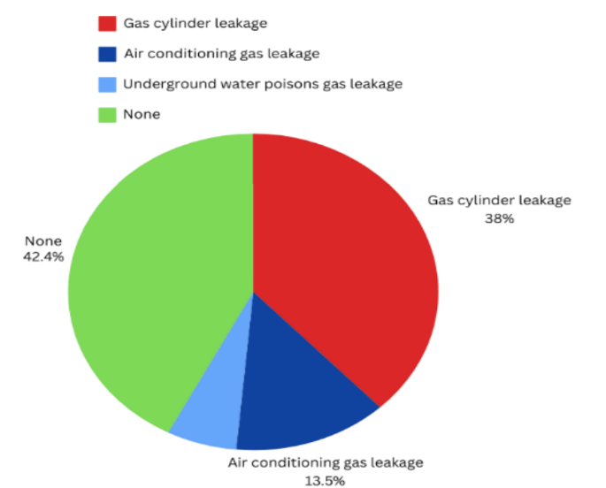
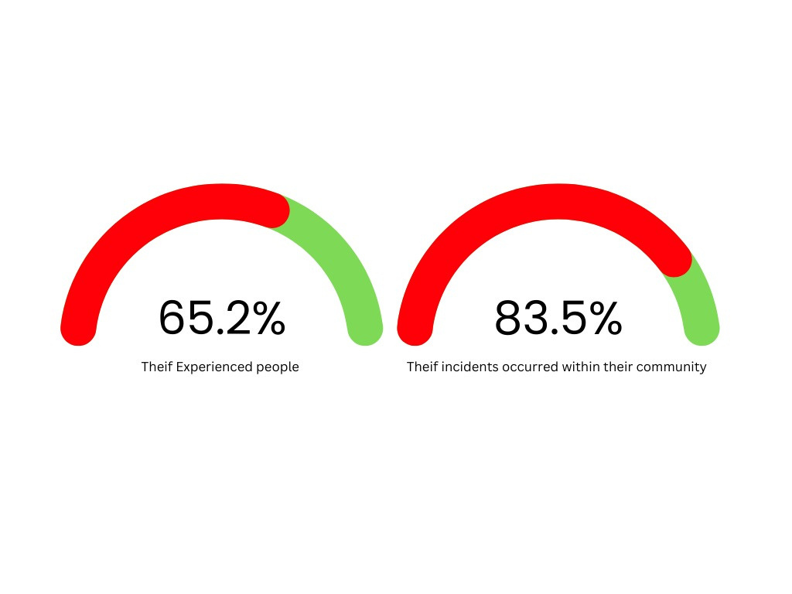
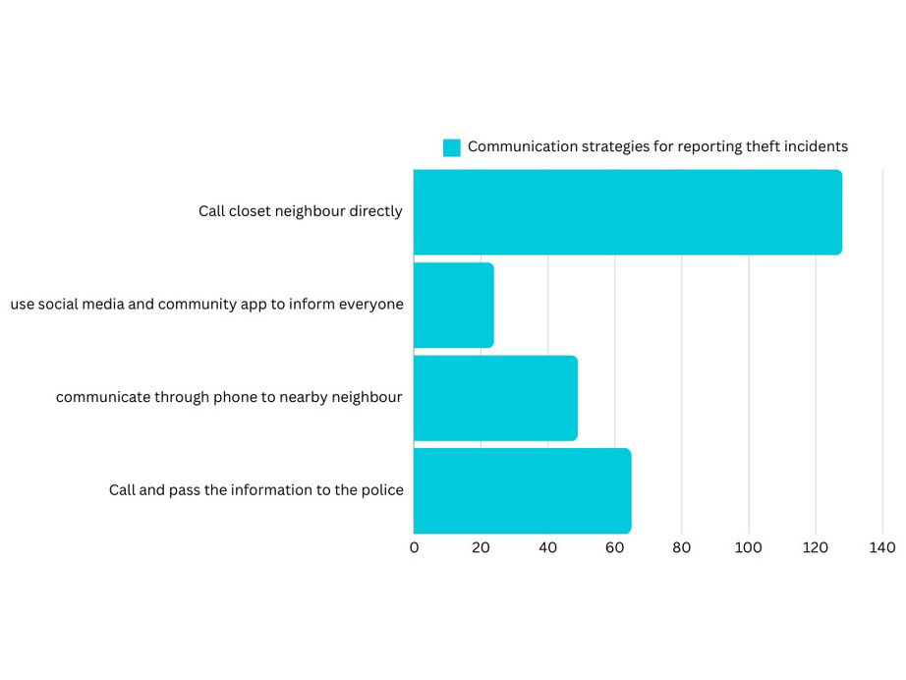
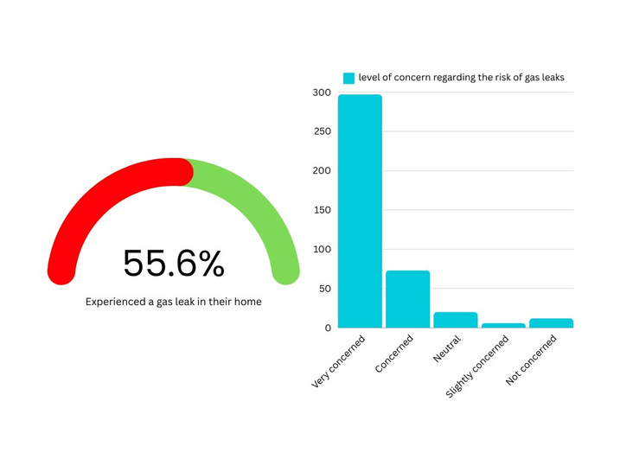
SUSTAINED 2024
Problem Formulation
Incidence of Theft Experiences
Preferred Methods for Reporting Theif
Awareness and Concerns About Gas Leaks
School of Engineering and Technology
Manav Rachna International Institute of Research and Studies Sec 43, Faridabad, Haryana, 121004, INDIA
2

Slide 8
SUSTAINED 2024
Methodology
Survey Details:
Sample size: 408 residents across Chennai.
Focus: Theft experiences, gas leaks, safety concerns, SDG awareness, AI feedback.
Proposed System:
AI-driven emergency detection for theft, fire, medical incidents, and air quality.
Features:
Push-button and voice-command alerts.
Solar-powered alarms and wireless communication.
Real-time monitoring and automated notifications.
Standards compliance: ISO/IEC 23894:2023, IEEE P2413, NFTA 72, UL268.
School of Engineering and Technology
Manav Rachna International Institute of Research and Studies Sec 43, Faridabad, Haryana, 121004, INDIA
2

Slide 9
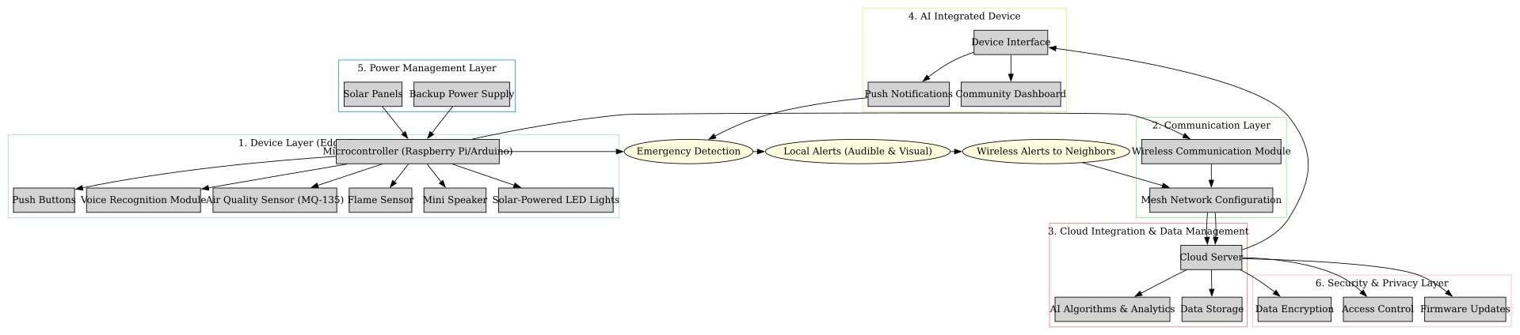
SUSTAINED 2024
Methodology
School of Engineering and Technology
Manav Rachna International Institute of Research and Studies Sec 43, Faridabad, Haryana, 121004, INDIA
2

Slide 10
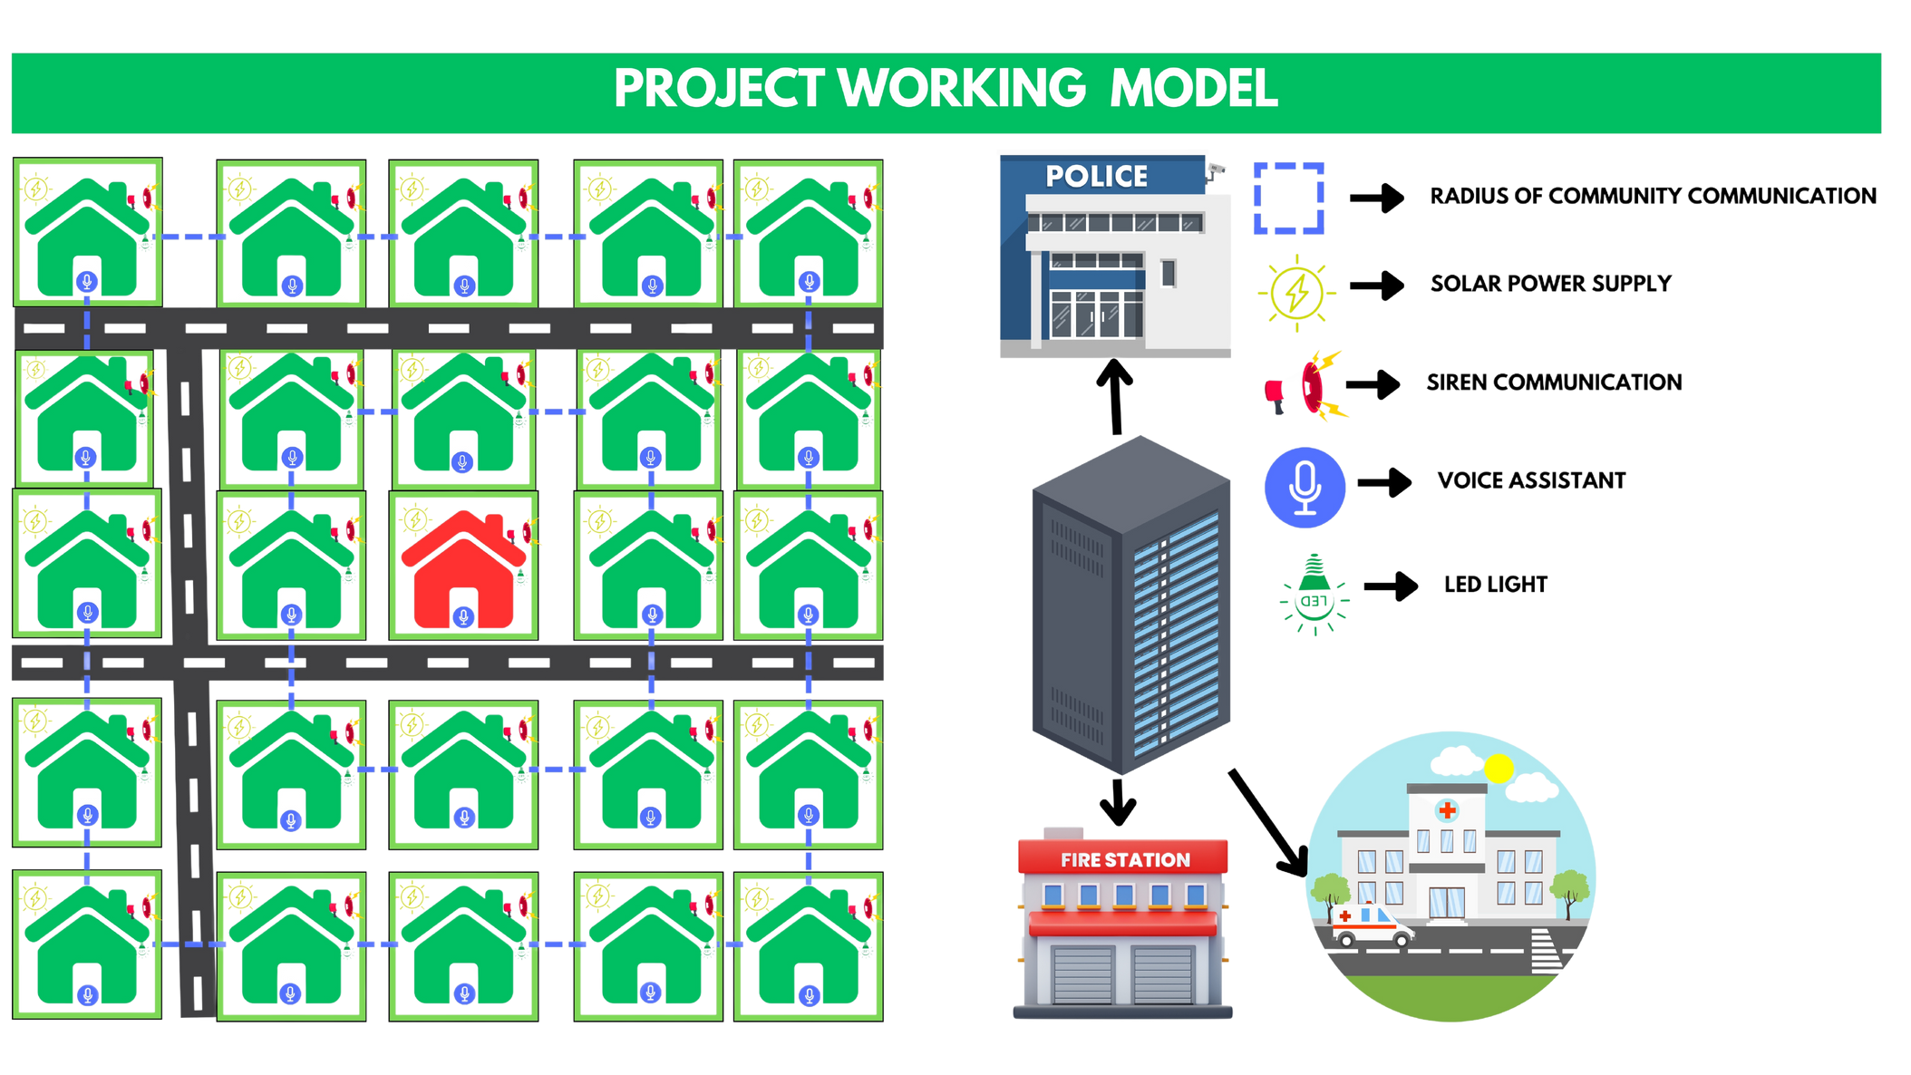
SUSTAINED 2024
School of Engineering and Technology
Manav Rachna International Institute of Research and Studies Sec 43, Faridabad, Haryana, 121004, INDIA
2

Slide 11
SUSTAINED 2024
Results and Discussion
Survey Findings:
Theft Concerns:
65.2% experienced theft; 83.5% occurred in community spaces.
Detection by neighbors (33.8%) or personal observation (28.2%).
Gas Leak Awareness:
Cylinder leaks (38%) most common; AC leaks (13.5%), underground leaks (6.1%).
Regional gas usage risks require targeted safety programs.
AI-Driven Safety Devices:
67.4% rated highly effective; 79.7% interested in testing/feedback.
SDG Awareness:
Only 14.7% aware; need to enhance understanding and community engagement.
School of Engineering and Technology
Manav Rachna International Institute of Research and Studies Sec 43, Faridabad, Haryana, 121004, INDIA
2

Slide 12
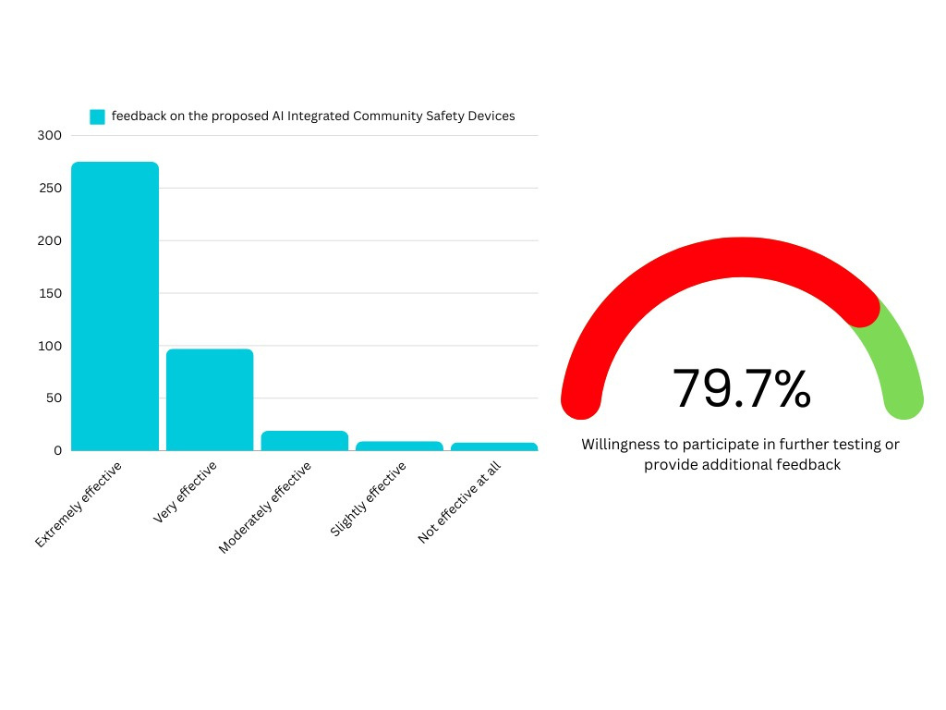
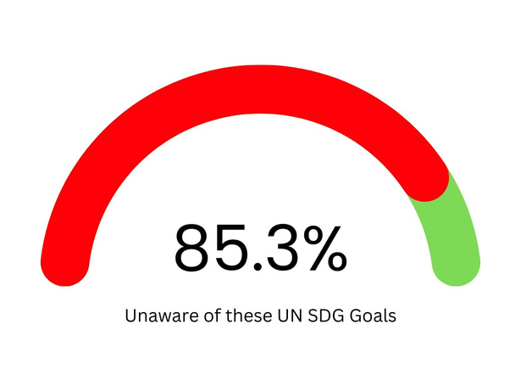
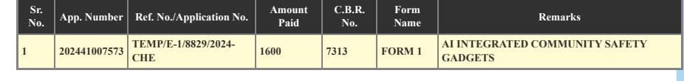
SUSTAINED 2024
Results and Discussion
Patent Filed
School of Engineering and Technology
Manav Rachna International Institute of Research and Studies Sec 43, Faridabad, Haryana, 121004, INDIA
2

Slide 13
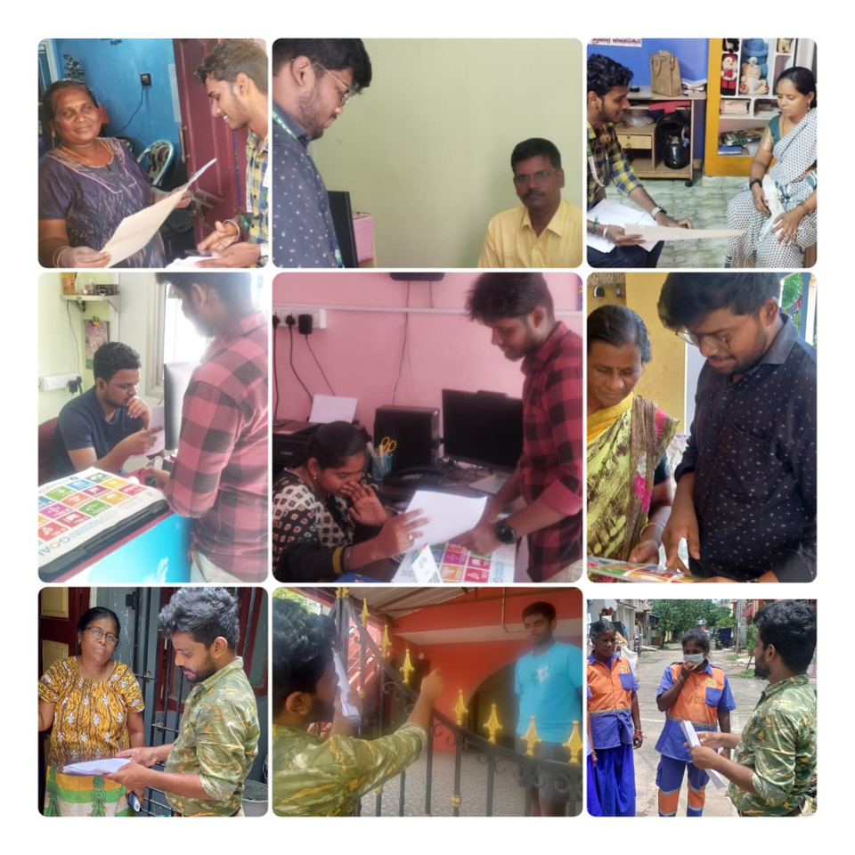
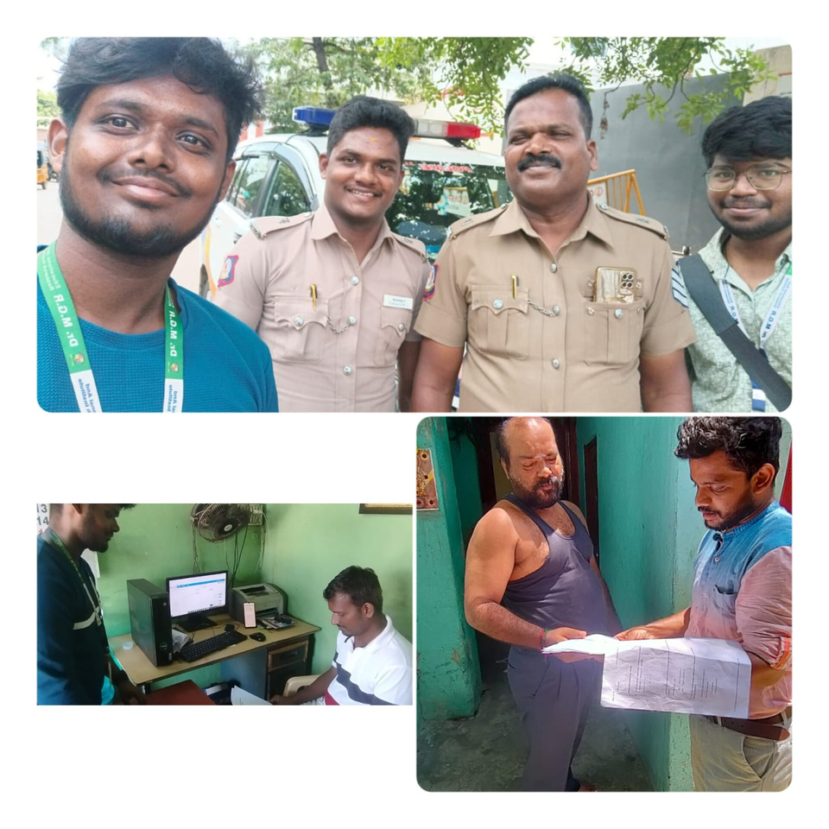
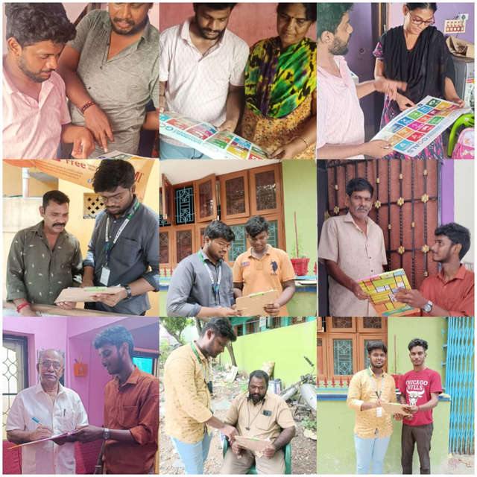
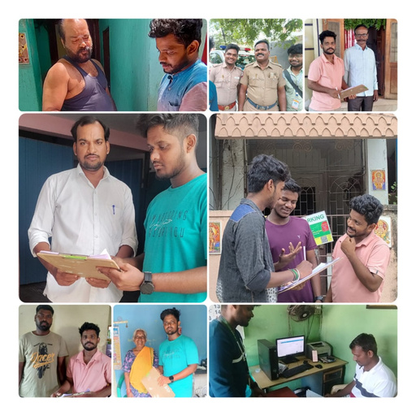

SUSTAINED 2024
Survey Photos
Scan to View all Survey Photos
School of Engineering and Technology
Manav Rachna International Institute of Research and Studies Sec 43, Faridabad, Haryana, 121004, INDIA
2

Slide 14
SUSTAINED 2024
Conclusion
Urban challenges like theft and gas leaks emphasize the need for AI-integrated safety solutions.
Strong support for technologies with real-time alerts and proactive responses.
Alignment with SDGs 9 (innovation and infrastructure) and 11 (sustainable cities).
Future directions:
System scalability and enhanced sensor capabilities.
Increased public awareness of SDGs and safety measures.
The Prototype preparation process is ongoing to refine the design and functionality.
Implementation of the project in village-side communities to address rural safety challenges and promote SDG alignment.
School of Engineering and Technology
Manav Rachna International Institute of Research and Studies Sec 43, Faridabad, Haryana, 121004, INDIA
2

Slide 15
SUSTAINED 2024
References
A. Sherif, S. Sherif, et al., "A LoRa-driven home security system for a residential community," International Journal of Technology, vol. 10, no. 7, pp. 1297-1306, 2019.
M. E. E. Alahi, et al., "Integration of IoT-enabled technologies and artificial intelligence (AI) for smart city scenarios," Sensors, vol. 23, no. 11, p. 5206, May 2023. [Online]. Available: https://doi.org/10.3390/s23115206
X. Li, R. Lu, et al., "Smart community: An Internet of Things application," IEEE Communications Magazine, vol. 49, no. 11, pp. 12-13, Nov. 2011. [Online]. Available: https://10.1109/MCOM.2011.6069779
School of Engineering and Technology
Manav Rachna International Institute of Research and Studies Sec 43, Faridabad, Haryana, 121004, INDIA
2

Slide 16
SUSTAINED 2024
Thank You
Queries and Discussion
Contact Details of Presenter:
igen.pious@gmail.com / 8610886066
School of Engineering and Technology
Manav Rachna International Institute of Research and Studies Sec 43, Faridabad, Haryana, 121004, INDIA
3

